Slide 1


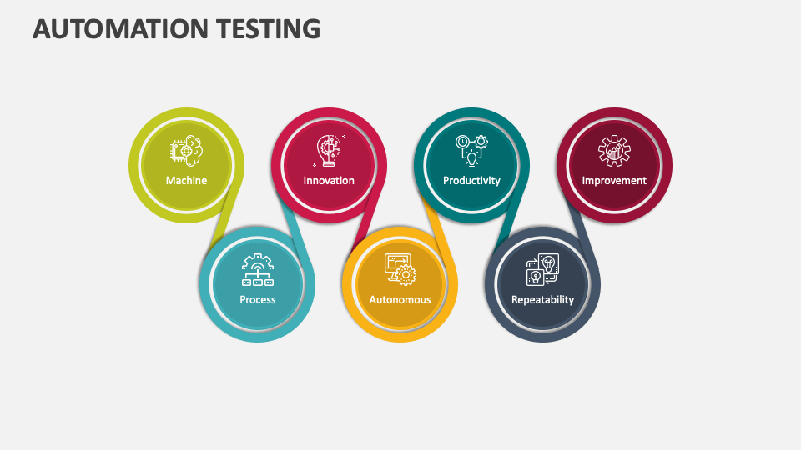
DS-Algo Project
2023, August
Presented By:
-Seema Singh
-Limna Koonjakkaran
-Smita Mandhan

Slide 2

Agenda
Objective
Integration Capability
Test Automation Framework Architecture
Step-by-Step Implementation Plan
Assumptions, Risks & Dependencies
Resources
Questions?

Slide 3
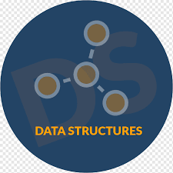
Introduction:-
Data Structure:The data structure is a particular way of organiation and storing data in a computer so that it can be accessed and modify efficiently
Data Structure and algorithm: A data structure is a named location that can be used to store and organize adat and ana algorithm is a collection of steps to solve a particular problem .
An algorithm is a process, defined in code, for carrying out a specific task. Searching a data structure is one of the most common programming activities ...
It is an Education domain project and designed for practicing data structure and algorithm.URL:-:https://dsportalapp.herokuapp.com/

Slide 4
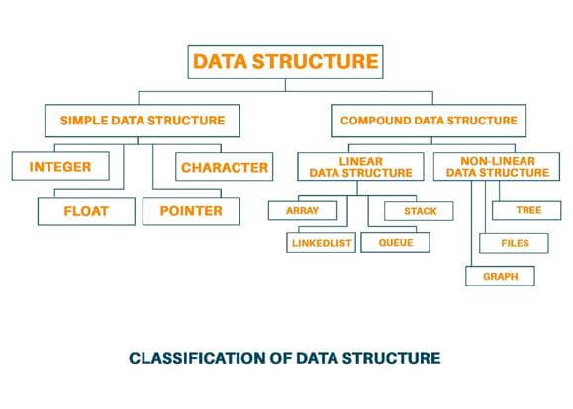
Objective:
Our primary objective is to select a suitable test automation tool while taking into account the software from existing procurement repository.
We automated the below DS features such as :
-Array
_Linked List
-Stack
-Queue
-Graph
-Tree

Slide 5
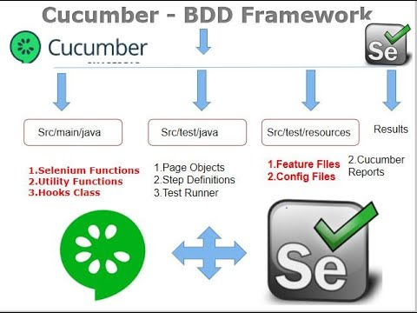
Cucumber BDD Framework:
Cucumber is one such open source tool, which supports behavior driven development. To be more precise, Cucumber can be defined as a testing framework, driven by plain English text.
To give structure and meaning to executable specification gherkin uses a set of special keywords such as Given,When and Then.
2023, August

Slide 6
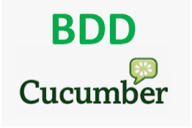



Framework and tools
Hybrid Framework-Cucumber BDD and TestNG
Build Tool-Apache Maven
Programming Language -Java
Data Driven-Excel sheet,Data Tables and Scenario outlines
Version Control Repository--Git/Github
Automation Server(CI/CD)-Jenkins
Report Generated-Allure,Extent,Cucumber,TestNg
Design-Page factory Model
Cross Browser Testing-Chrome,Firefox and Edge
Logging Tool-Log4J2
Bug Tracking Tool-Jira
2023, August

Slide 7
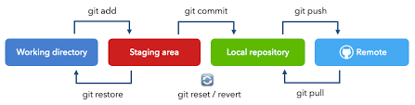
Git and GitHub Integration
Git track changes via a distributed version control system.this means that git can track the stage of different version of your project.
GitHub:Git is a version control system.It helps you keep track of code changes and also used to collaborate on code.It is a Hub where Git user build software together.
Git Staging Environment:One of the core function of Git is the concept of the staging Environment and the commit.As you are working, you may be adding,editing and removing files.but whenever you hit a milestone or finish a part of the work,you should add the files to a staging environment
Staged files are the files that are ready to be committed to the repository you are working on
2023, August

Slide 8
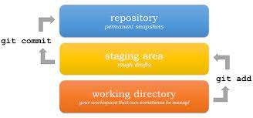
GitHuB branches and its Advantage
Branches allow you to develop feature,fix bugs or safely experiment with new ideas in a contained area of repository.
Git and other version control systems give software developers the power to track, manage, and organize their code.
In particular, Git helps developers collaborate on code with teammates; combining powerful features like commits and branches with specific principles and strategies helps teams organize code and reduce the time needed to manage versioning.
Of course, every developer and development team is different, with unique needs. Here is where a Git branching strategy comes in.
We will be covering three fairly popular Git branch strategies, each with their own benefits. The best part? None of these workflows are set in stone and can, and should, be modified to fit your specific environment and needs.
2023, August

Slide 9
GitHub Screenshot from the System pending

Slide 10
Jenkins

Slide 11
Test Run
Screen shot Pending

Slide 12
Test Run out Put Screen Shot Pending

Slide 13
Reports Screen shot :

Slide 14
Reports Screen shot :

Slide 15
Reports Screen shot :

Slide 16
DS-Algo Project Structure /Skeleton
Screen shot Of the project from Eclipse
Pending
2023, August

Slide 17
Challenge and Resources
Challenges:
Building Project framework
Handling dynamic web elements pop ups and dialogs
Integration with jenkins
Committing new changes in Github
Resources:
Numpy Ninja
Naveen Automation
Stackflow
2023, August

Slide 18


